Slide 1
Meltdown & Spectre Attacks

Slide 2
Overview
An analogy
CPU cache and use it as side channel
Meltdown attack
Spectre attack

Slide 3


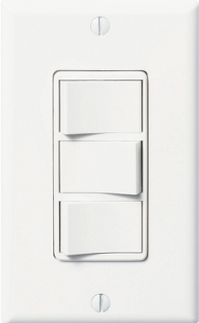
Microsoft Interview Question

Slide 4
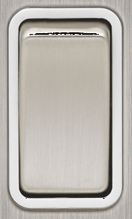

Stealing A Secret
Secret: 7
Guard with
Memory
Eraser
Restricted Room

Slide 5
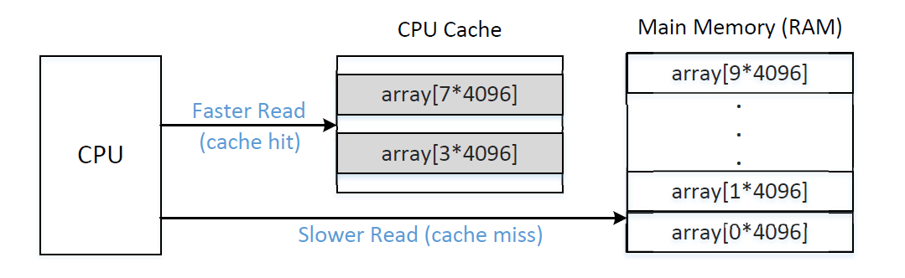
CPU Cache

Slide 6

From Lights to CPU Cache
Question
You just learned a secret number 7, and you want to keep it. However, your memory will be erased and whatever you do will be rolled back (except the CPU cache). How do you recall the secret after your memory about this secret number is erased?

Slide 7
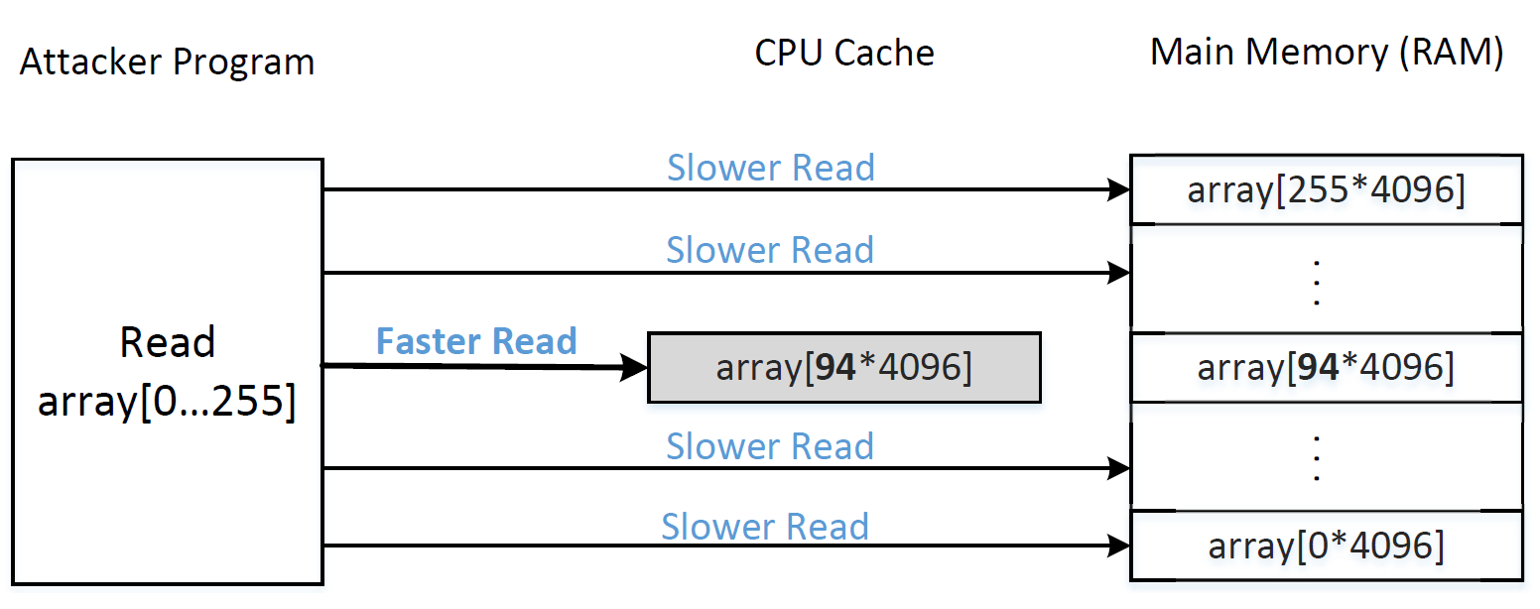
Using CPU Cache to Remember Secret

Slide 8
The FLUSH+RELOAD Technique
Secret S
FLUSH:
Flush the
CPU Cache
Access memory location at S
RELOAD:
Check which one is in the cache

Slide 9
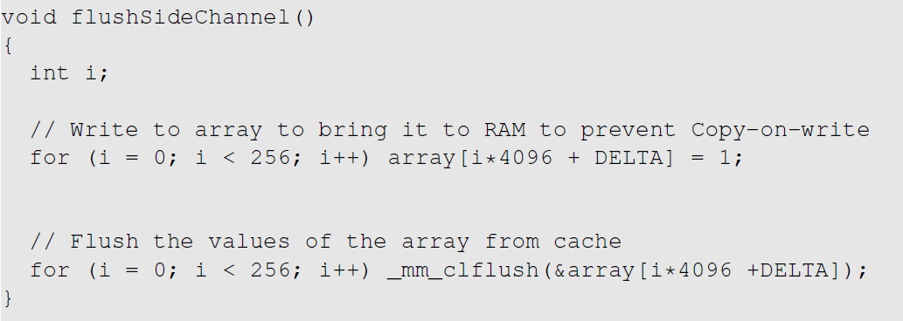
FLUSH+RELOAD: The FLUSH Step
Flush the CPU Cache

Slide 10
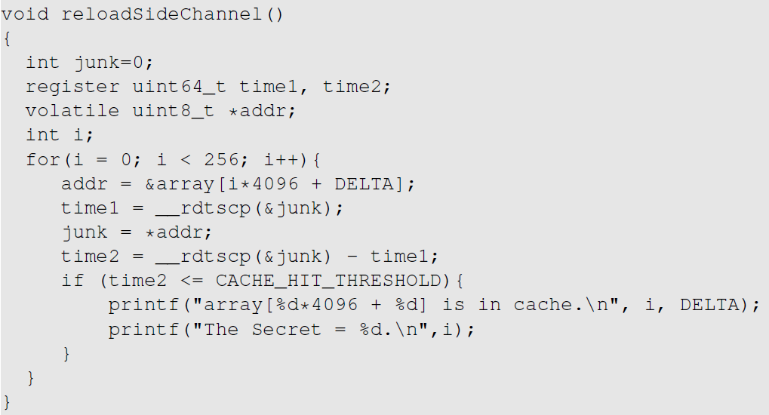
FLUSH+RELOAD: The RELOAD Step

Slide 11
The Meltdown Attack

Slide 12
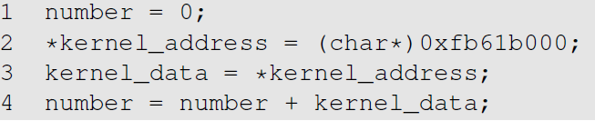
The Security Room and Guard

Slide 13
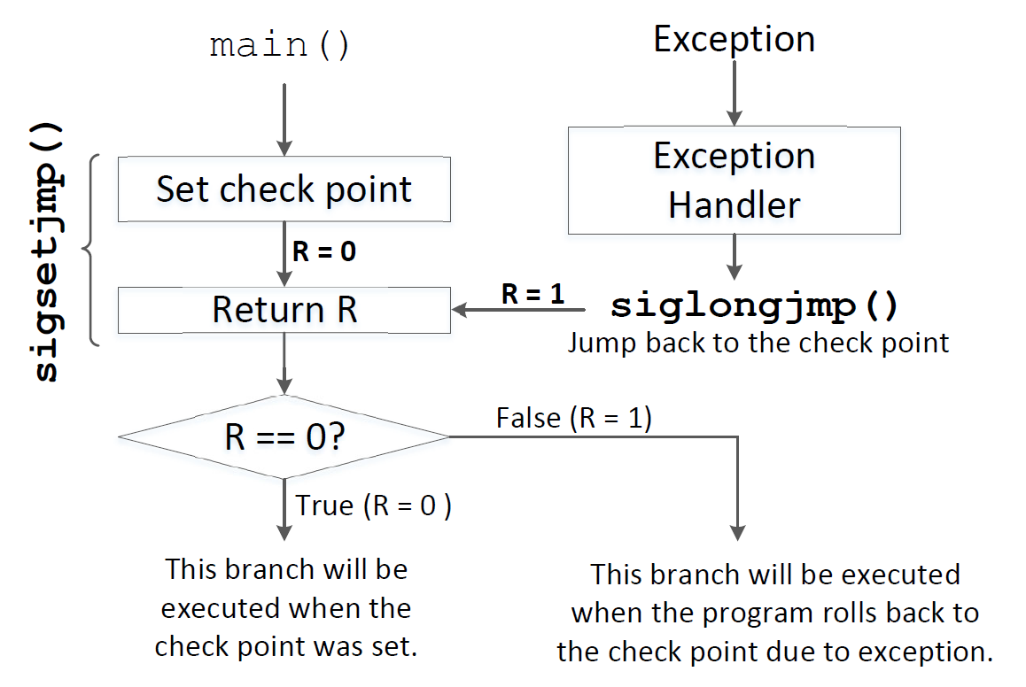
Staying Alive: Exception Handling in C

Slide 14
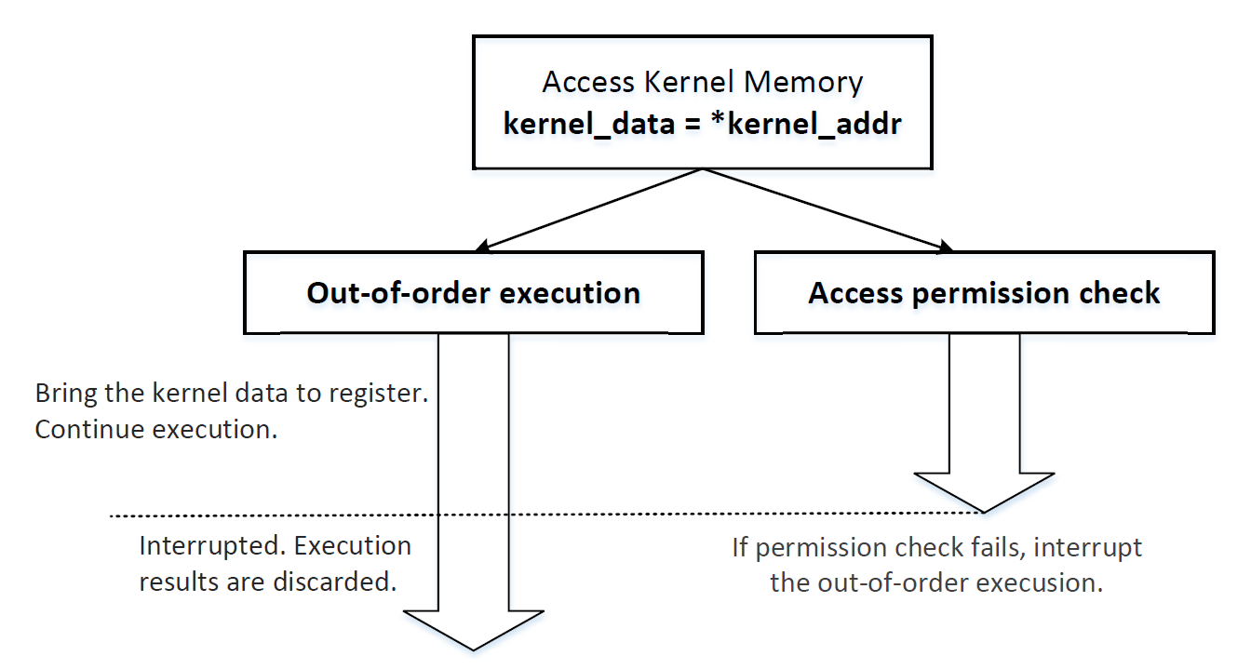
Out-Of-Order Execution

Slide 15
Out-of-Order Execution
How do I prove that the out-of-order execution has happened?

Slide 16
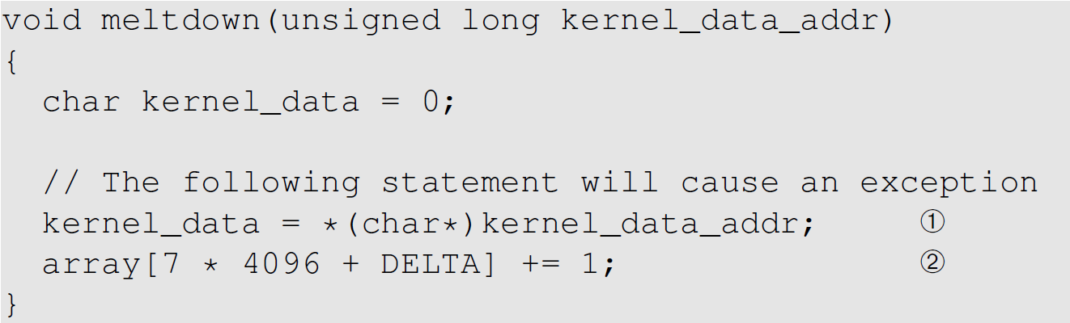
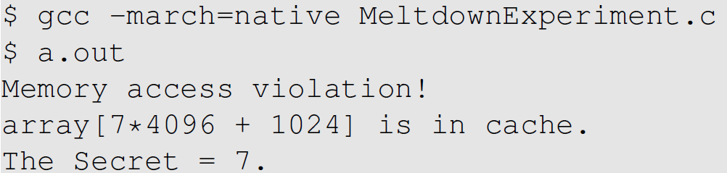
Out-of-Order Execution Experiment
Evidence of out-of-order
execution

Slide 17
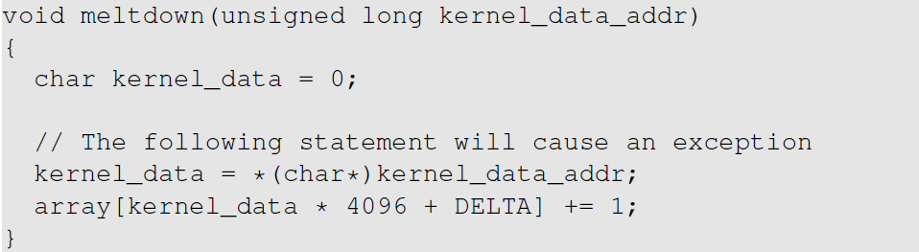
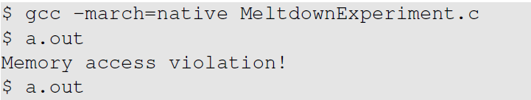

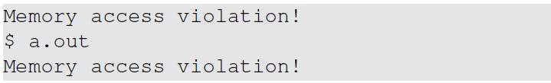
Meltdown Attack: A Naïve Approach

Slide 18
Improvement: Get Secret Cached
Why does this help?

Slide 19
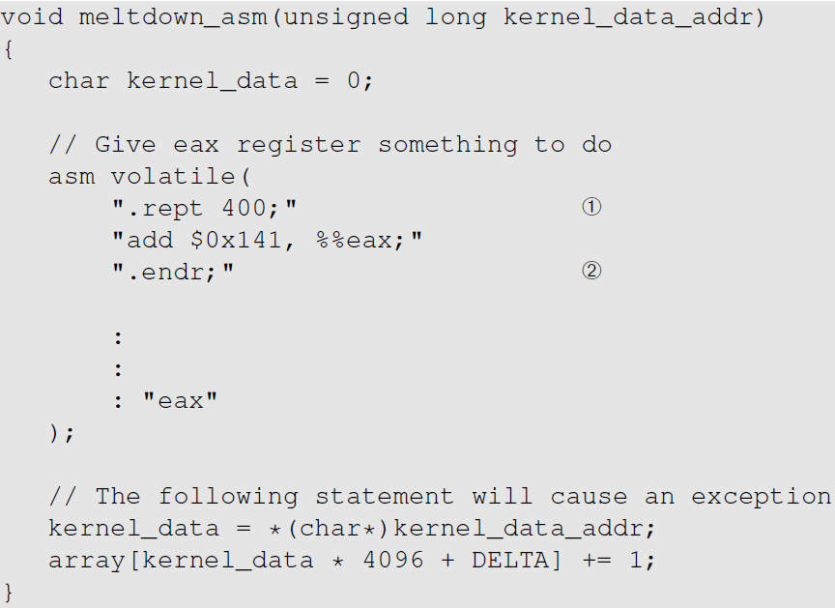
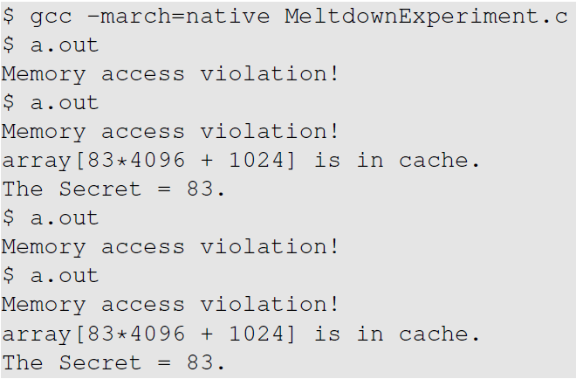
Improve the Attack Using Assembly Code
Execution Results

Slide 20
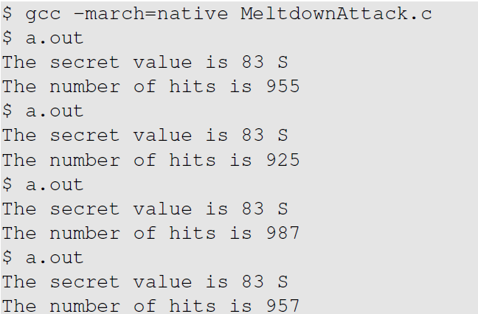
Improve the Attack Using Statistic Approach

Slide 21
Countermeasures
Fundamental problem is in the CPU hardware
Expensive to fix
Develop workaround in operating system
KASLR (Kernel Address Space Layout Randomization)
Does not map any kernel memory in the user space, except for some parts required by the x86 architecture (e.g., interrupt handlers)
User-level programs cannot directly use kernel memory addresses, as such addresses cannot be resolved

Slide 22
The Spectre Attack

Slide 23
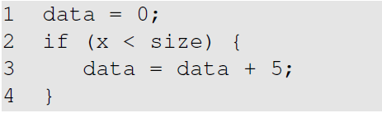
Will It Be Executed?
Will Line 3 be executed if x > size ?

Slide 24
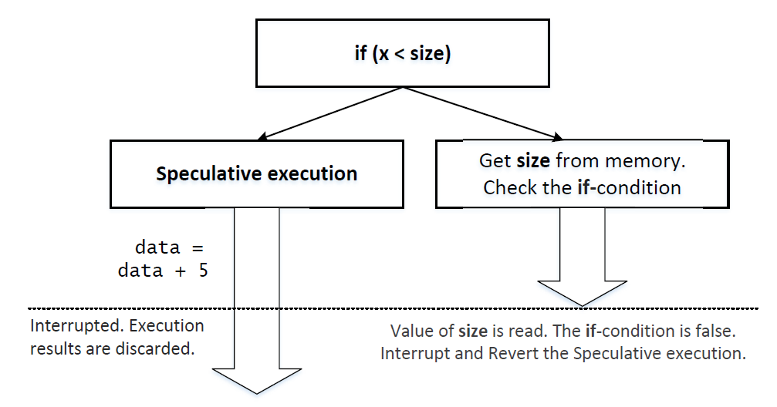
Out-Of-Order Execution

Slide 25
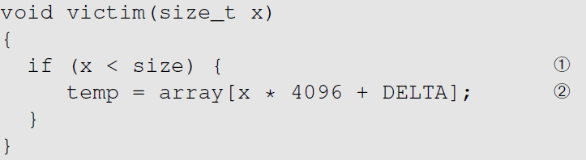
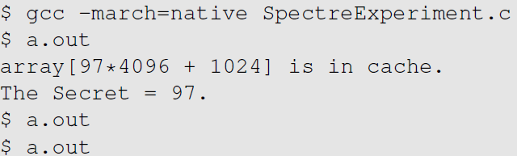
Let’s Find a Proof
size is 10
Training
Train CPU to go to the true branch
FLUSH
Flush the
CPU Cache
Invoke
victim(97)
RELOAD
Check which one is in the cache
Evidence
Not always working though

Slide 26
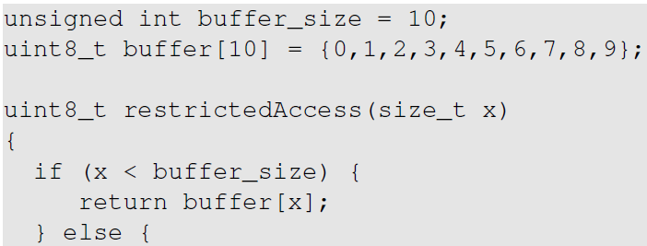
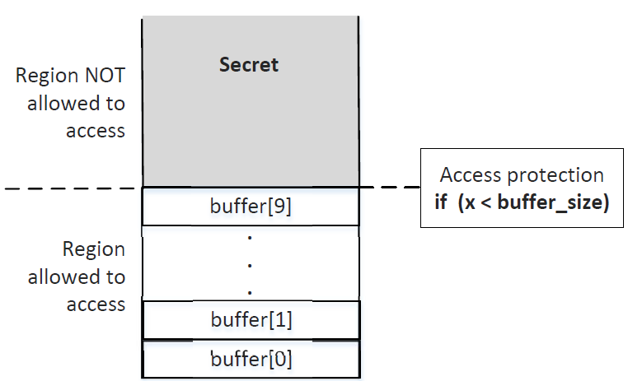
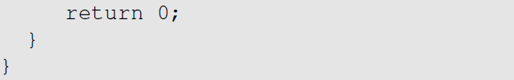
Target of the Attack
This protection pattern is widely
used in software sandbox (such as those implemented inside browsers)

Slide 27
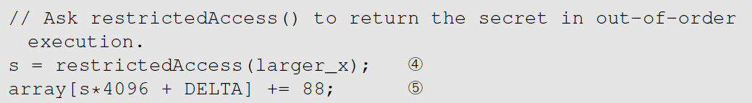
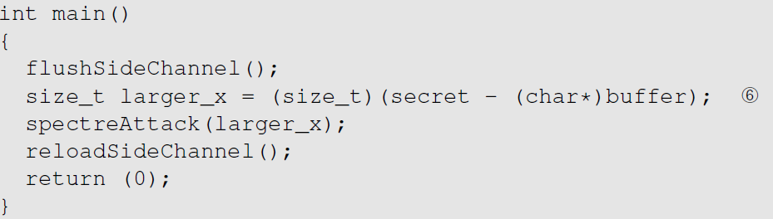
The Spectre Attack
spectreAttack(int larger_x)

Slide 28
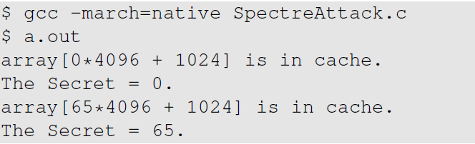
Attack Result
Why is 0 in the cache?
Success

Slide 29
Spectre Variant and Mitigation
Since it was discovered in 2017, several Spectre variants have been found
Affecting Intel, ARM, and ARM
The problem is in hardware
Unlike Meltdown, there is no easy software workaround

Slide 30
Summary
Stealing secrets using side channels
Meltdown attack
Spectre attack
A form of race condition vulnerability
Vulnerabilities are inside hardware
AMD, Intel, and ARM are affected

